Slide 1

Java Full Stack Internship
A Project Presentation on
JP008 - Car Rental System
Under the guidance of
Archana
Software Engineer
DLithe
Presented by,
Umar Hanif Baji - 337CS21011
Darshan D Shetty - 337CS21002
Kumar Sujal - 337CS21006
Balaji V Kodle - 337CS22703
Harsha - 337CS22705

Slide 2
Contents
Introduction
Problem statement
Objectives
Methodology
Implementation
Results and analysis
Conclusion
References

Slide 3
Introduction
This car rental system is a digital platform that allows customers to rent vehicles of their preference for a defined number of days.
It provides customer with an interface which allows them to filter and search vehicles by specific features or browse the inventory in general.
Customers can view a diverse fleet of vehicles ranging from sports cars to SUVs. They have the ability for flexible pricing, vehicle type any many more attributes

Slide 4
Problem Statement(UseCase)
The current way of renting cars offline is inefficient and has a lengthy process, making it hard for people to quickly get the vehicles they need. Issues like long waits, unclear prices, not enough cars available, and too much paperwork make renting cars frustrating. With the online platform, the method of renting cars becomes streamlined and seamless.

Slide 5
Objectives
To provide:
1. Efficient and user-friendly car rental processes.
2. Transparent pricing structures and policies.
3. Wide availability of vehicles to meet customer demand.
4. Streamlined operations for a seamless rental experience.

Slide 6
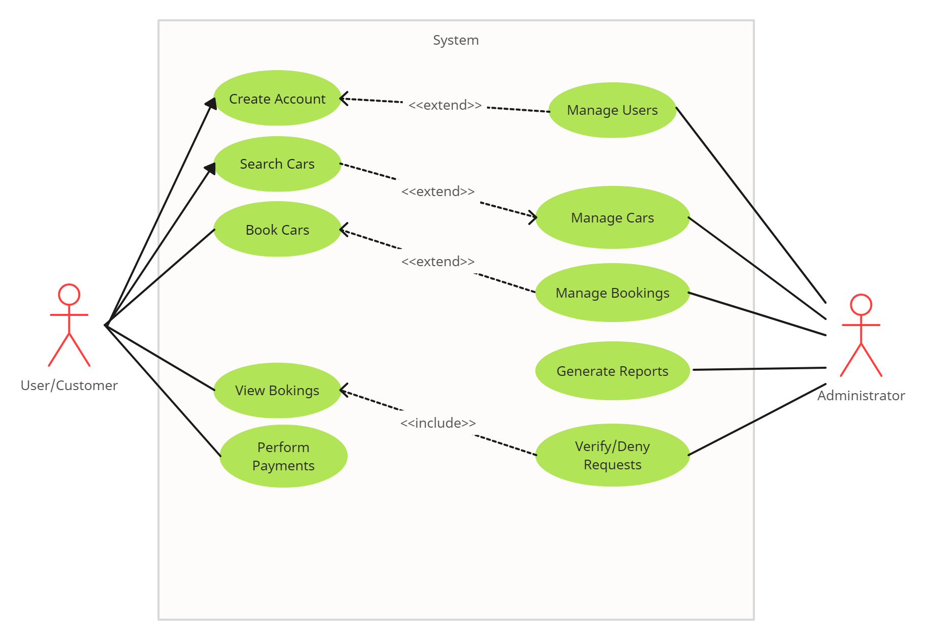
UseCase Diagram
Use Case Diagram for Car Rental System

Slide 7
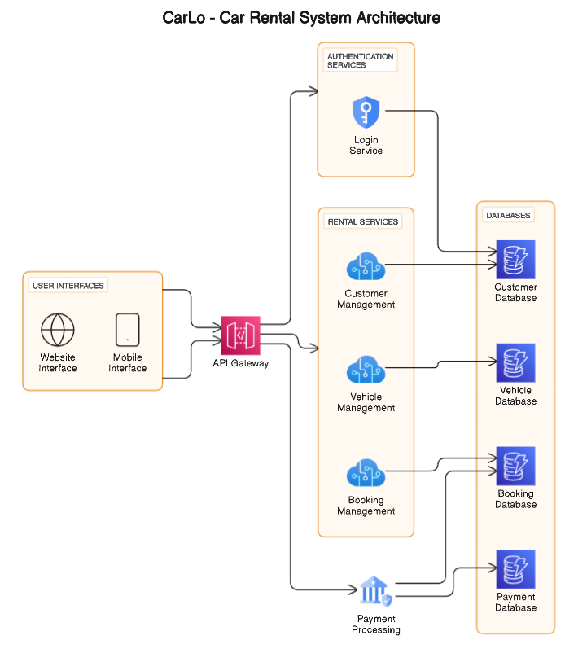
Architecture Diagram
Car Rental System Architecture Design

Slide 8
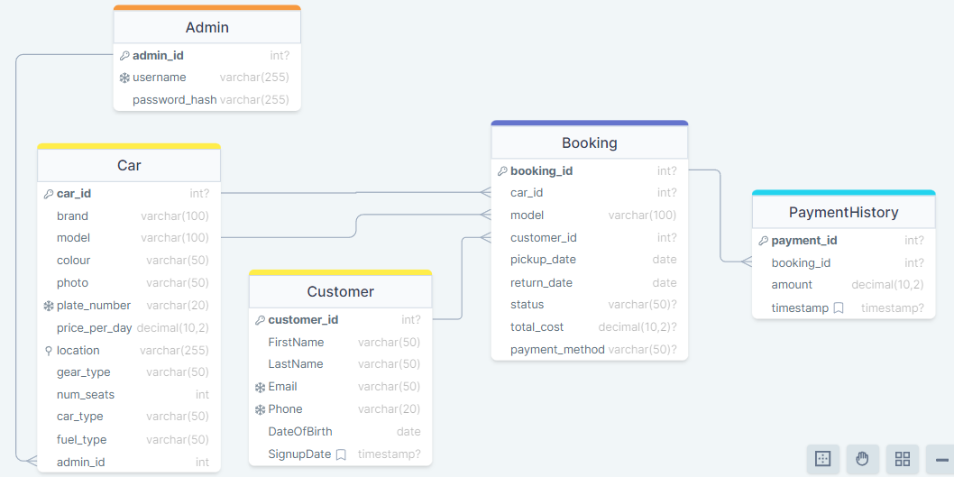
Schema Diagram
Car Rental System Database Schema

Slide 9
Implementation
Database Design: Efficiently store car, customer, and reservation data.
User Interface (UI): Develop a user-friendly interface for customers and administrators.
Authentication & Authorization: Ensure secure access with proper authentication mechanisms.
Car Management: Enable adding, updating, and removing cars with relevant details.
Reservation System: Allow customers to browse, select, and reserve cars with date options.
Payment Integration: Integrate secure online payment gateways for reservations.
Rental History & Reporting: Track past reservations and financial performance.
Admin Panel: Provide administrators with tools to manage system entities.
Project Execution

Slide 10
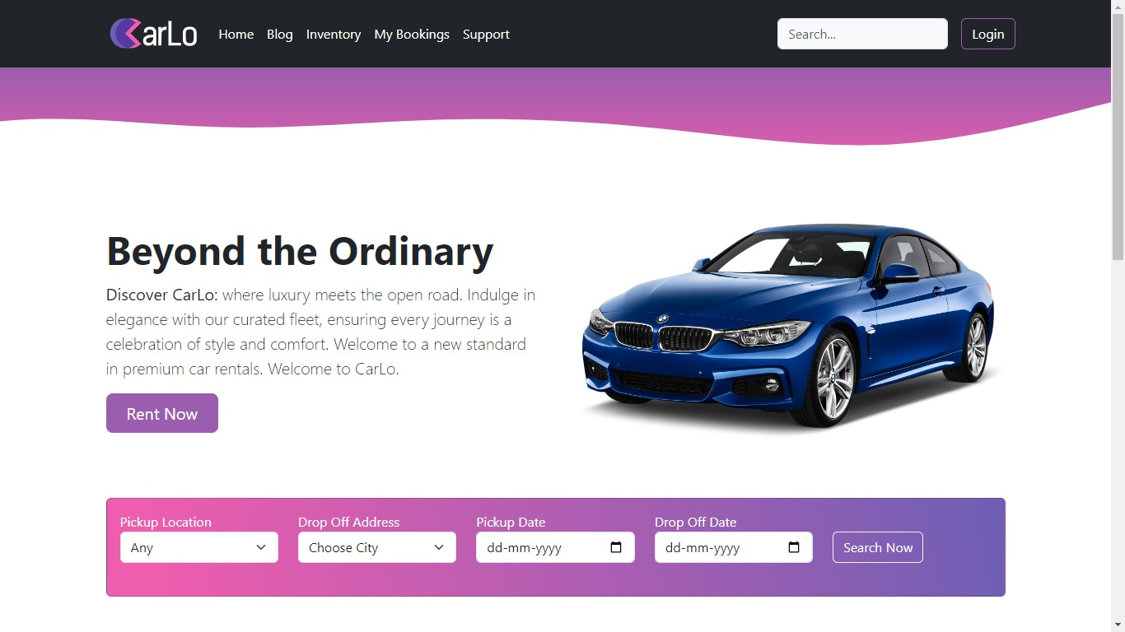
RESULTS AND ANALYSIS
Figure 1: Customer Landing Page

Slide 11
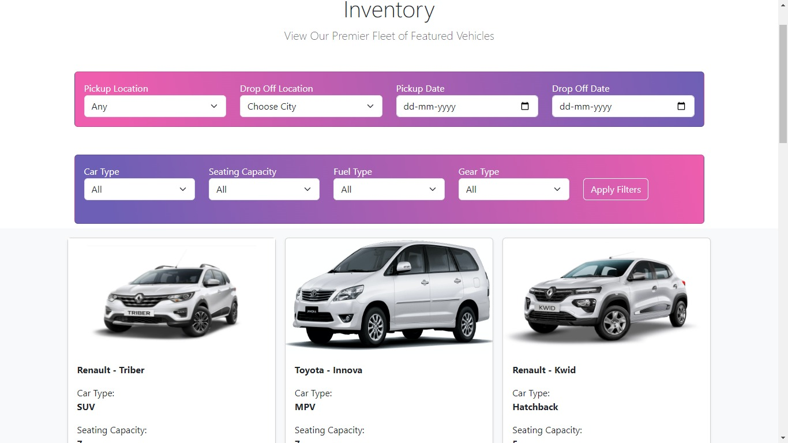
RESULTS AND ANALYSIS
Figure 2: Vehicle Inventory

Slide 12
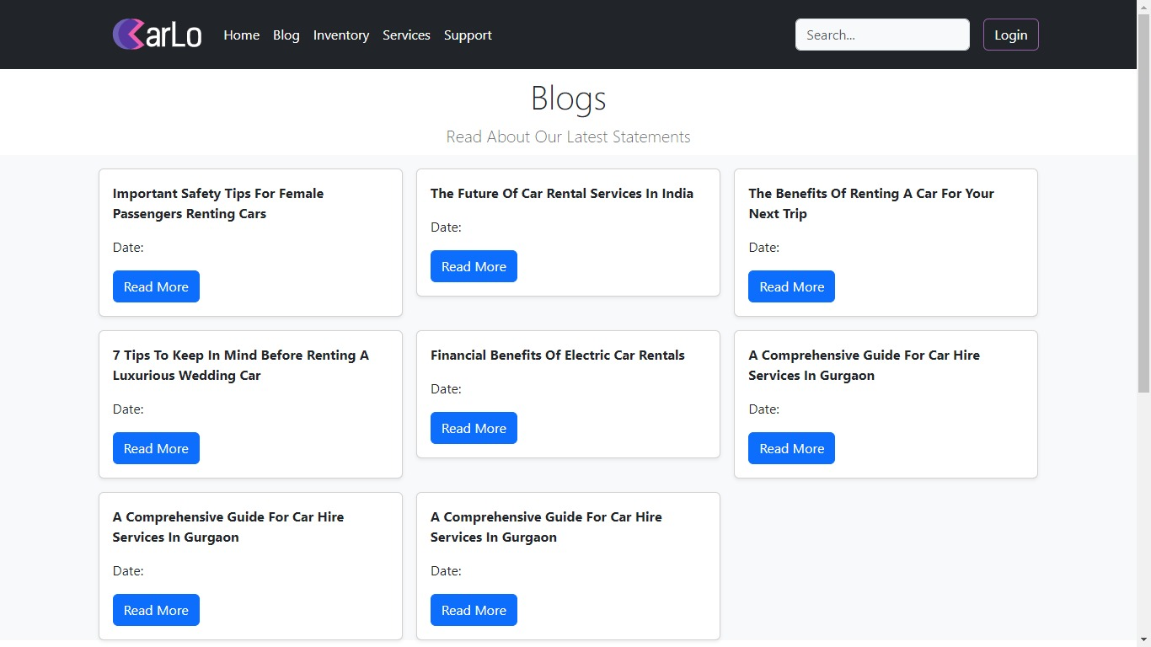
RESULTS AND ANALYSIS
Figure 3: Vehicle Blog Section

Slide 13
Database Management: The database efficiently stored and managed data related to cars, customers, bookings, and rental history. Queries were executed promptly, ensuring retrieval of information and smooth system operation.
User Interface: The user interface provided an intuitive and user-friendly experience for both customers and administrators. Users can navigate effortlessly through the system, with clear options for browsing cars and making reservations.
Car Management: The car management functionalities allows for seamless management of the car inventory. Administrators can easily add, update, and remove cars, ensuring accurate and up-to-date information for customers.

Slide 14
Reservation System: The reservation system facilitated smooth and hassle-free booking experiences for customers. Users could browse available cars, select rental dates, and make reservations with ease, resulting in high customer satisfaction.
Payment Integration: Secure payment gateways facilitated smooth transactions for reservations, ensuring the security of customer payment information. Payment processes were seamless, enhancing the overall user experience.
Rental History: The tracking of rental history and booking features provided valuable insights for admins and customers. Admins can manage booking status and customers can view it accordingly.

Slide 15
Conclusion
In conclusion, the successful implementation of our car rental system represents a solution to our problem statement. Through structured planning and execution, we have constructed a platform that streamlines the car rental process for all members involved. With an emphasis on user-friendliness, accessibility, and efficiency, our system provides customers with a satisfying user experience

Slide 16
In future we would like to implement the following:
User Feedback: Gathers feedback from users to identify areas for improvement and address any issues they may have encountered.
Expand Payment Options: Offer a wider range of payment options to customers, like stripe and PayPal.
Accessibility: Ensure that the application is accessible to users with disabilities by adhering to accessibility standards and guidelines.
Data Analytics: Gather data to get insights into user behavior, preferences, and trends, enabling data-driven decision-making and targeted marketing efforts.

Slide 17
References
[1] Smith, J. (2023). "User-Centric Design Principles for Digital Applications." Journal of User Experience, 8(2), 123-135.
[2] Johnson, A. (2022). "Scalability Strategies for Web Applications." Proceedings of the International Conference on Software Engineering (ICSE), 45-52.

Slide 18
THANK YOU

